Slide 1
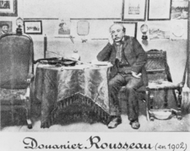
Henri Rousseau
(1844 - 1910)

Slide 2
To learn about the life and works of the famous French painter Henri Rousseau.
To develop your reading and dictionary skills.

Slide 3
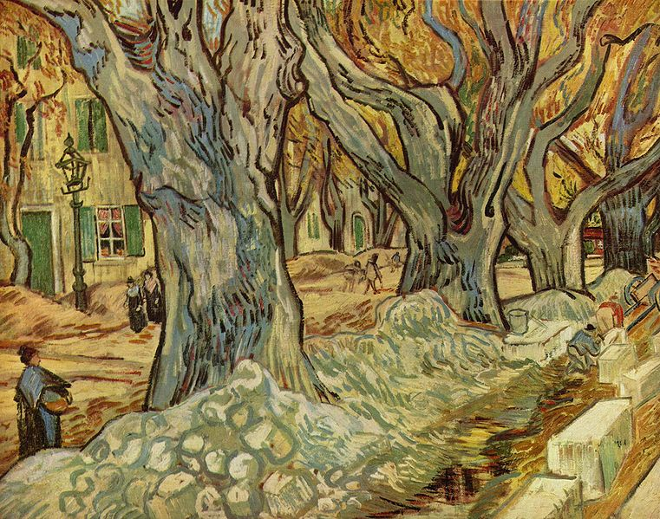
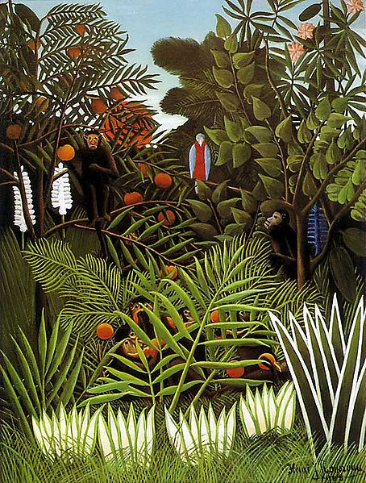
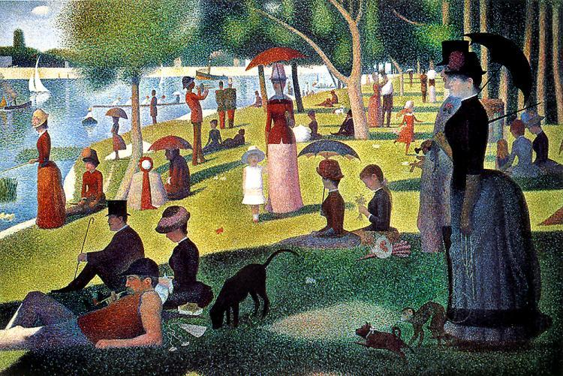
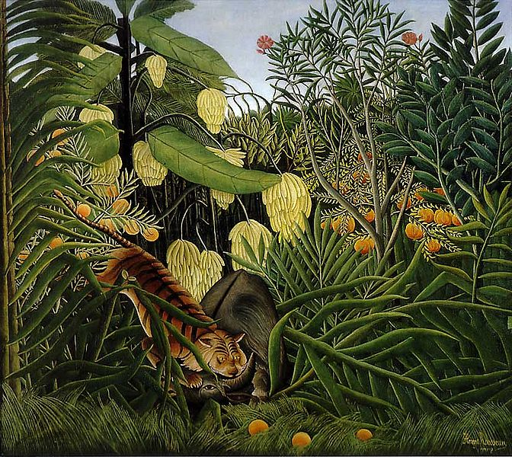
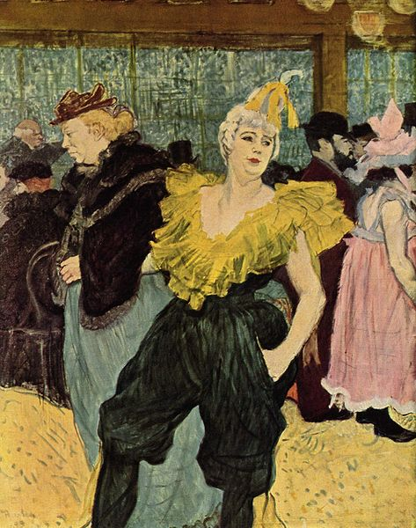
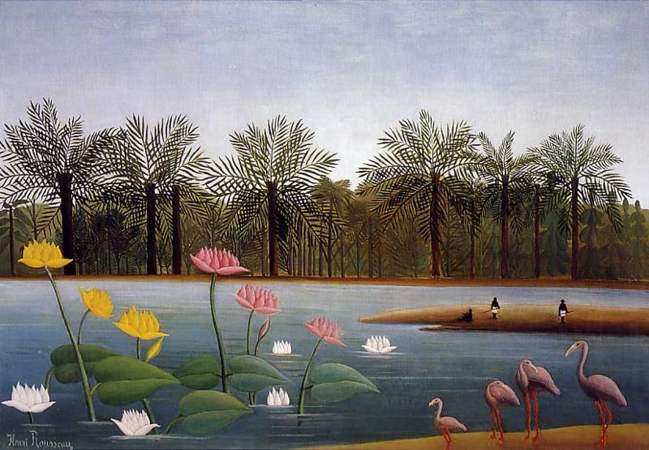
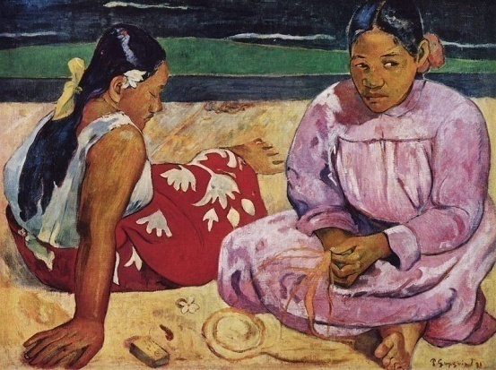
c
a
b
e
d
f
g
Notes:
Pupils identify which paintings were painted by Henri Rousseau.

Slide 4
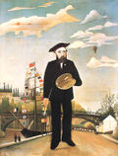
Une vidéo
Notes:
Hyperlink to the You Tube video about his life and work.

Slide 5
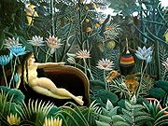
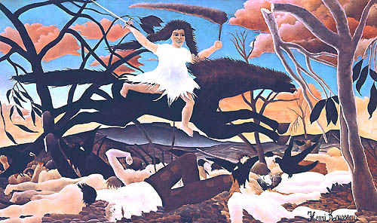
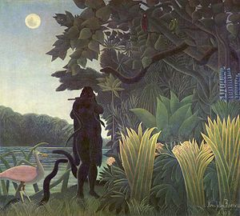
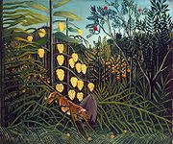
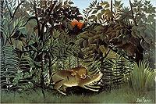
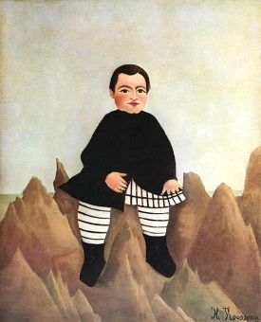
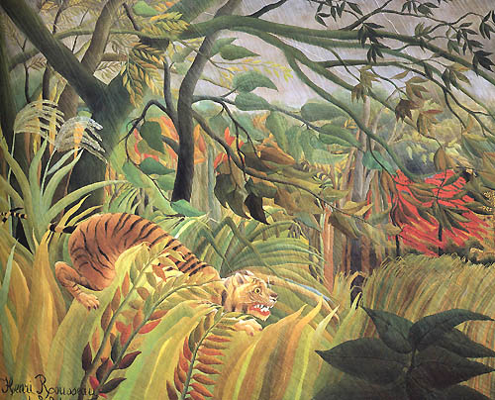
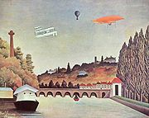
1
2
3
4
L’enfant aux rochers
Combat de tigre et buffle
Vue du pont
de Sèvres
Le lion ayant faim se jette sur l’antilope
Tigre dans une tempête tropicale!
La charmeuse de serpents
Le Rêve
La guerre
8
5
6
7
Notes:
Objective – to use different reading skills to match the title to each picture.
5

Slide 6
Reading skills
Don’t try and understand
every word. Read for gist.
Use a dictionary sparingly – try to identify key words
Use what you do know to work out what you don’t.
Look for cognates.
Notes:
Pupils were told they were going to be given a long, detailed, authentic text about the life and works of Henri Rousseau which was taken directly from the internet. My aim was to develop their skills and confidence when reading longer, unfamiliar texts.

Slide 7
Identifying
key words
Notes:
Before they saw the reading task, 15 of the key words from the text on Henri Rousseau were hidden around the room. Pupils worked in pairs. One person went around the room looking for the words, the other stayed at their table with a dictionary. When the person found a word, they had to memorize it and go back to their partner who wrote it down and then looked up the meaning in the dictionary. The winners were the pair who had found all 15 words, spelled them accurately and found their English meaning correctly.

Slide 8
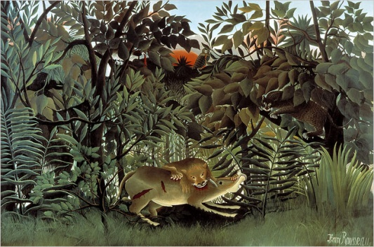
Bridge Map
La vie et les peintures
d’Henri Rousseau
Le jardin
des plantes
artiste
peinture
ton
animal
--------------------
-------------------
----------------
------------------
-----------------------
Relating Factor: means the same as...
Notes:
The starter for this next lesson was a thinking skills “bridge map” where they had to find a synonym for the 5 items featured. (These were all provided by the identifying key words activity at the end of the previous lesson). This activity was a good way of recalling this new vocabulary.

Slide 9
To develop your reading by studying an authentic French text about Henri Rousseau.
To be able to describe a picture in French.
To improve your dictionary skills.
Notes:
Pupils were then given the text and reminded of the reading skill strategies we had discussed in the previous lesson. They then had a time limit to read it through in pairs and answer the questions. They were only allowed a dictionary for the last 2-3 minutes! They then fedback.

Slide 10
The, a, some ????
 | masculin | féminin | pluriel
the
a
some
le
la
les
un
une
des
du
de la
des
Attention: de l’ pour les mots qui
commencent avec une voyelle ou un “h”.
Notes:
Dictionary skills practice. Pupils were given a series of words to look up and reminded about which articles to use. This was further consolidated with mini whiteboards.

Slide 11
To improve your dictionary skills.
To learn how to use verb tables.
To be able to describe a picture in French.

Slide 12


Le dictionnaire........
C’est mon meilleur ami!!

Slide 13
Notes:
Pupils were given a copy of this picture and a dictionary in pairs. They then had 5 mins to complete the blank thinking skills “circle map” with the objects they could see in the picture.

Slide 14
Dans l’image,
on peut voir..
/ il y a ...

Slide 15
un buisson
un singe
un perroquet
la jungle
une fleur
Dans l’image,
on peut voir..
/ il y a ...
un arbre
le soleil
des oranges
de l’herbe
une feuille
une branche
un oiseau
le ciel
Notes:
Feedback and further discussion of articles.

Slide 16
vert vif
verte vive
vert foncé
un buisson
vert pâle
un singe
un perroquet
panaché
vert clair
la jungle
une fleur
Dans l’image,
on peut voir..
/ il y a ...
long /
longue
un arbre
le soleil
des oranges
de l’herbe
court
une feuille
une branche
méchant
pointu
un oiseau
le ciel
un massif de...
exotique
une touffe de....
Notes:
They then had some more time to add adjectives to these nouns.
Feedback. Pupils encouraged to recall position and agreement of adjectives in French.

Slide 17
v

Slide 18
Verb tables
It is eating
They are eating
It is watching
They are watching
It is staring
It is sitting
They are sitting
He is hiding
They are hiding
Il mange
Ils mangent
Il regarde (tout droit)
Ils regardent (tout droit)
Il regarde fixement
Il est assis
Ils sont assis
Il se cache
Ils se cachent
Notes:
Explanation and practice of how to use verb tables in the dictionary. Further consolidation with mini whiteboards.

Slide 19
Using previous knowledge
sur
sous
à côté de
en face de
entre
derrière
devant
between
behind
under
in front of
on
next to
opposite

Slide 20
À l’arrière plan
au centre
de l’image
à gauche
à droite
au coin
au premier plan

Slide 21
To consolidate the structures needed to describe a picture.
To be able to accurately describe a picture to another person.
To be able to ask questions to get an accurate picture.
To be able to compare and contrast 2 paintings.
Notes:
Hyperlinks to task magic practising key language taught in previous lesson.

Slide 22
Qu’est-ce qu’il y a....?
C’est de quelle couleur?
Qu’est-ce qu’il fait?
C’est à gauche?
Il ya combien de ....?

Slide 23
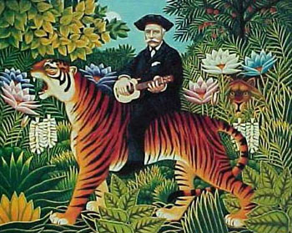
Tableau 1
Notes:
One half of the class was given this painting. In pairs they had to try and come up with a description. The other half were given the second painting on the next slide and they had to do the same thing. After a few mins, one half of the class had to ask the other half for a description of their painting and ask questions for clarification. As the description was being given they drew a rough sketch of what they thought the picture looked like. (This could also work quite well as a pair work activity with them describing in turn their picture to a partner). They then compared their sketches to the original pictures!

Slide 24

Tableau 2

Slide 25
v
Tableau 1
Tableau 2

Slide 26
Absence de
lumière
v
Un homme
est assis sur
un tigre
des oranges
des régimes
de bananes
des fleurs
exotiques
Les arbres
Tableau 1
Tableau 2
le
Un tigre/un lion
se cache
derrière
des branches
Le tigre
attaque
un buffle
Un tigre
L’homme joue
de la
mandoline
Le tigre a
faim
La jungle
Le tigre n’a pas
faim
Un buffle
a
Absence de
perspective
Notes:
As a planning tool, pupils used a thinking skills “double bubble” map to compare and contrast the 2 pictures.

Slide 27
Des phrases utiles
Dans le premier tableau....
Dans le deuxième tableau....
Les deux tableaux se caractérisent par...
Les caractéristiques techniques....
Comparable/ différent
Aussi...
Cependant...
En revanche.....
A mon avis...
Je pense que...
Personnellement, je préfère le ........... tableau parce que......
C’est plus (moins) dramatique/ fantastique / horrible / réaliste / imaginaire / bizarre que....
C’est comme un rêve.
L’autre tableau est...
Je préfère le sujet du ................ tableau.
Notes:
They then wrote up their thoughts on both paintings.

